Slide 1
Turing Machine Variations

Slide 2




The Standard Model
Infinite Tape
Read-Write Head
(Left or Right)
Control Unit
Deterministic

Slide 3
Variations of the Standard Model
Turing machines with:
Stay-Option
Semi-Infinite Tape
Off-Line
Multi tape
Multidimensional
Nondeterministic
Different Turing Machine Classes

Slide 4
Same Power of two machine classes:
both classes accept the
same set of languages
We will prove:
each new class has the same power
with Standard Turing Machine
(accept Turing-Recognizable Languages)

Slide 5
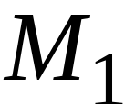
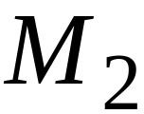
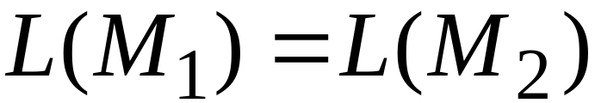
Same Power of two classes means:
for any machine of first class
there is a machine of second class
such that:
and vice-versa

Slide 6
Simulation:
A technique to prove same power.
Simulate the machine of one class
with a machine of the other class
Second Class
Simulation Machine
First Class
Original Machine
simulates

Slide 7
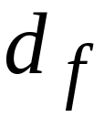
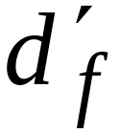
Accepting Configuration
Original Machine:
Simulation Machine:
the Simulation Machine
and the Original Machine
accept the same strings

Slide 8
Turing Machines with Stay-Option
Not moving the TAPE HEAD-Stay option
The head can stay in the same position
Left, Right, Stay
L,R,S: possible head moves

Slide 9


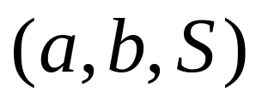
Example:
Time 1
Time 2

Slide 10
Theorem:
Stay-Option machines
have the same power with
Standard Turing machines
Proof:
1. Stay-Option Machines
simulate Standard Turing machines
2.
Standard Turing machines
simulate Stay-Option machines

Slide 11
1. Stay-Option Machines
simulate Standard Turing machines
Trivial: any standard Turing machine
is also a Stay-Option machine

Slide 12
2.
Standard Turing machines
simulate Stay-Option machines
We need to simulate the stay head option
with two head moves, one left and one right

Slide 13
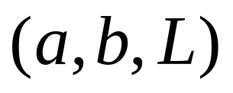
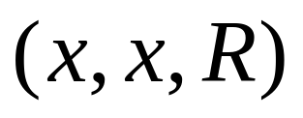


Stay-Option Machine
Simulation in Standard Machine
For every possible tape symbol

Slide 14
For other transitions nothing changes
Stay-Option Machine
Simulation in Standard Machine
Similar for Right moves

Slide 15

example of simulation
Stay-Option Machine:
1
2
Simulation in Standard Machine:
1
2
3
END OF PROOF

Slide 16

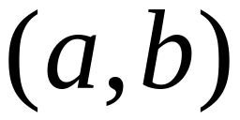
Multiple Track Tape
A useful trick to perform more
complicated simulations
One Tape
track 1
track 2
One head
One symbol

Slide 17
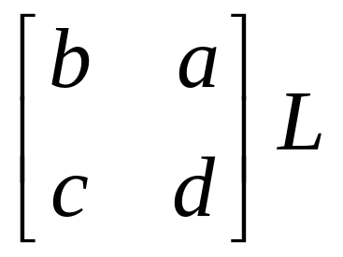
track 1
track 2
track 1
track 2

Slide 18
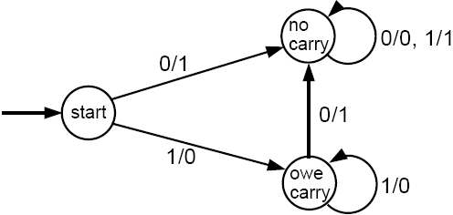
Adding of two numbers by ktrack TM
Below is given a moore machine for incrementing a binary number by 1.
Can you build a TM on the same logic for
  adding two binary numbers (Assignment)
  adding two decimal numbers (Assignment)

Slide 19
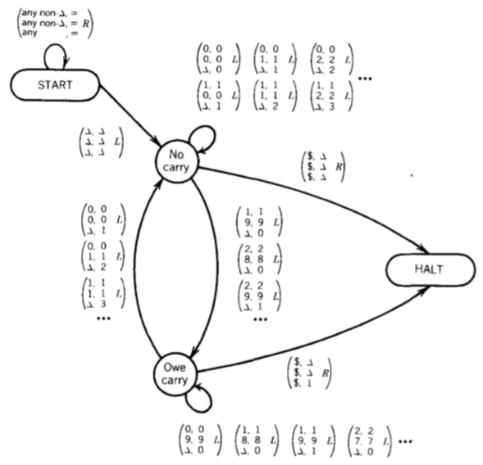
Adding of two numbers by ktrack TM

Slide 20
Adding of two numbers by ktrack TM
$ | 4 | 2 | 9
$ | 9 | 3 | 3
$ | ∆ | ∆ | ∆
$ | 4 | 2 | 9
$ | 9 | 3 | 3
$ | ∆ | ∆ | ∆
$ | 4 | 2 | 9
$ | 9 | 3 | 3
$ | ∆ | ∆ | ∆
$ | 4 | 2 | 9
$ | 9 | 3 | 3
$ | ∆ | ∆ | ∆
$ | 4 | 2 | 9
$ | 9 | 3 | 3
$ | ∆ | ∆ | ∆
No-Carry
Owe-Carry
No-Carry
Owe-Carry
Halt
$ | 4 | 2 | 9
$ | 9 | 3 | 3
$ | ∆ | ∆ | 2
$ | 4 | 2 | 9
$ | 9 | 3 | 3
$ | ∆ | ∆ | 2
$ | 4 | 2 | 9
$ | 9 | 3 | 3
$ | ∆ | 6 | 2
$ | 4 | 2 | 9
$ | 9 | 3 | 3
$ | 3 | 6 | 2
$ | 4 | 2 | 9
$ | 9 | 3 | 3
1 | 3 | 6 | 2

Slide 21


Nondeterministic Turing Machines
Choice 1
Choice 2
Allows Non Deterministic Choices

Slide 22
Time 0
Time 1
Choice 1
Choice 2

Slide 23
Theorem:
Nondeterministic machines
have the same power with
Standard Turing machines
Proof:
1. Nondeterministic machines
simulate Standard Turing machines
2.
Standard Turing machines
simulate Nondeterministic machines

Slide 24
1. Nondeterministic Machines simulate
Standard (deterministic) Turing Machines
Trivial: every deterministic machine
is also nondeterministic

Slide 25
2. Standard (deterministic) Turing machines
simulate Nondeterministic machines:
Deterministic machine:
Uses a 2-dimensional tape
(which is equivalent to 1-dimensional tape)
Stores all possible computations
of the non-deterministic machine
on the 2-dimensional tape

Slide 26
All possible computation paths
Initial state
Step 1
Step 2
Step i
reject
infinite
path
accept
Step i+1

Slide 27
The Deterministic Turing machine
simulates all possible computation paths:
simultaneously
step-by-step
in a breadth-first search fashion

Slide 28

Nondeterministic machine
Time 0
Deterministic machine
current
configuration

Slide 29

Nondeterministic machine
Time 1
Choice 1
Choice 2
Deterministic machine
Computation 1
Computation 2

Slide 30
Deterministic Turing machine
Repeat
  For each configuration in current step
  of non-deterministic machine,
if there are two or more choices:
1. Replicate configuration
2. Change the state in the replicas
Until either the input string is accepted
or rejected in all configurations
END OF PROOF

Slide 31
Remark:
The simulation takes in the worst case exponential time compared to the shortest accepting path length of the
nondeterministic machine

